Slide 1



Slide 2


هل السرطان مرض وراثي ؟
Is Cancer a Genetic Disease ?

Slide 3

Genetic Material المادة الوراثية المادة المولدة المادة الأصل
إشكالية المصطلحGenetics vs Heredity
بين الوراثي و الموروث Genetic vs inherited
Genetics , ancient Greek Genetikos meaning genitive, generative, Genesis (Origin).
Gene, German Gen, Ancient Greek Genea meaning come into being.
Genesis.
Oxygen, Hydrogen, Fibrinogen, Pathogen, Mutagen, Antigen, Mitogen, Carcinogen, Chromogen ….
المادة الوراثية «المولدة» تنتقل بالوراثة.
الخلل في المادة الوراثية «المولدة» ليس بالضرورة أن يكون موروثا.

Slide 4
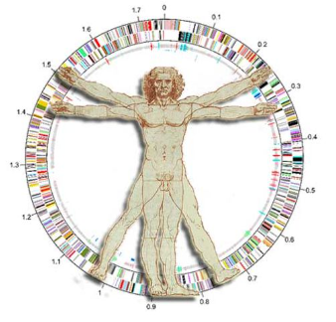
Genome
The complete set of genetic information in an organism.
Exons + Introns.
HG19 : 19969 genes.
3 billion base pairs.

Slide 5
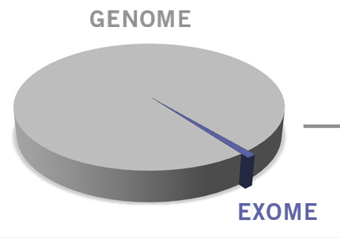
Exome
All Genome’s Exons.
1.5% of the Genome.

Slide 6

Types of Genes that Cause Cancer
Proto-oncogenes are involved in normal cell growth and division. However, when these genes are altered in certain ways or are more active than normal, they may become cancer-causing genes (or oncogenes), allowing cells to grow and survive when they should not.
Tumor suppressor genes are also involved in controlling cell growth and division. Cells with certain alterations in tumor suppressor genes may divide in an uncontrolled manner.
DNA repair genes are involved in fixing damaged DNA. Cells with mutations in these genes tend to develop additional mutations in other genes and changes in their chromosomes, such as duplications and deletions of chromosome parts. Together, these mutations may cause the cells to become cancerous.

Slide 7
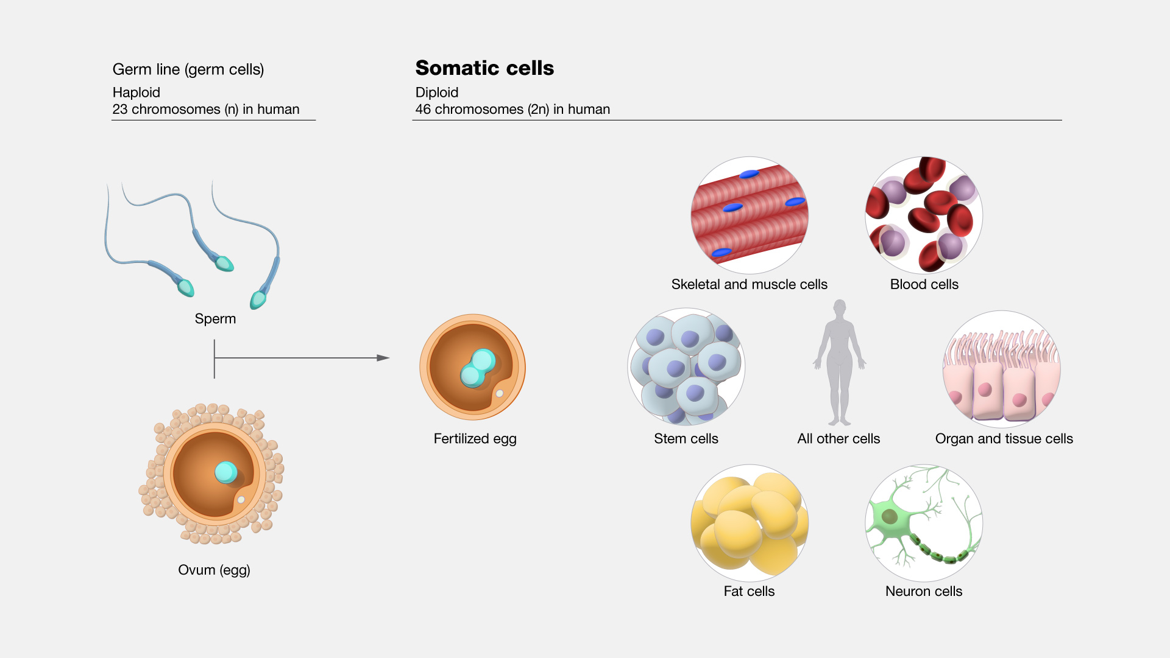
Germline cells vs Somatic cells

Slide 8
Mutations
Germline vs Somatic

Slide 9
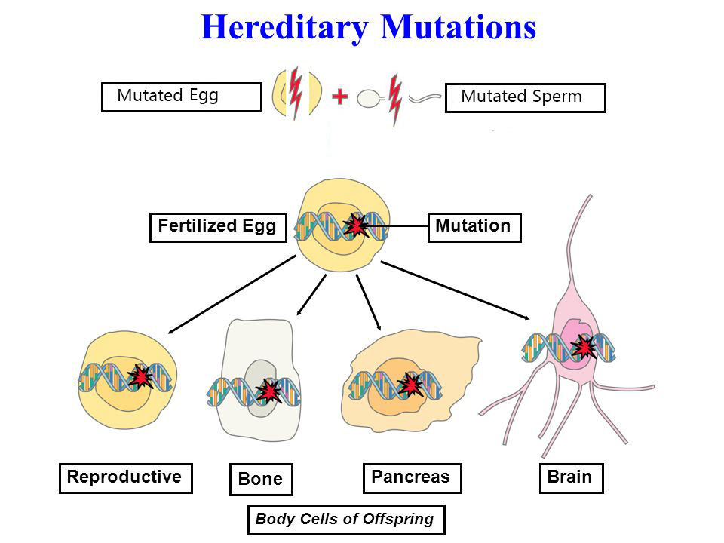
Germline Mutations (Inherited)

Slide 10
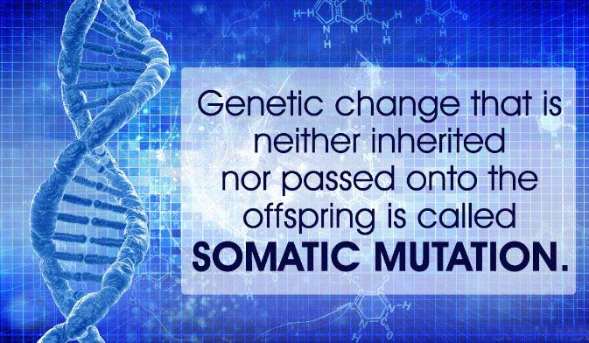

Slide 11

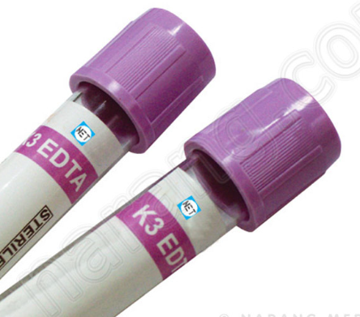
BRCA 1 / 2
GERMLINE
SOMATIC
Inherited mutation.
Inheritable to the Offspring.
Found in all body cells.
Sample of choice for testing is :
Peripheral Blood (EDTA).
Not inherited mutation.
Not inheritable to the Offspring.
Found only in affected tumor cells.
Sample of choice for testing is :
FFPE tumor tissue.

Slide 12
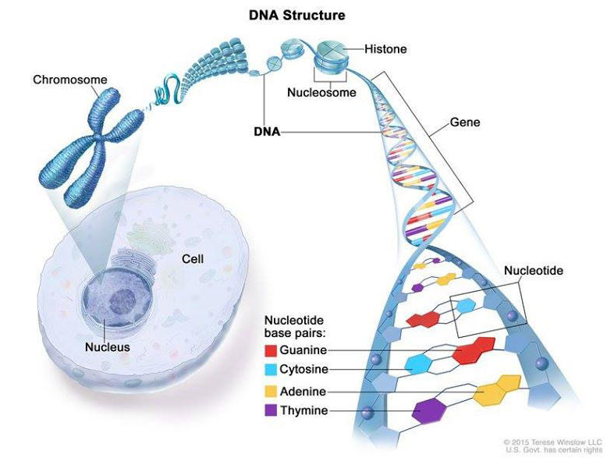

Slide 13
Genetic material Aberrations related to Cancer
Epigenetics Aberration
The aberration of gene expression that do not involve alterations in the DNA sequence.
Chromatin fiber condensation aberration, DNA methylation, histone acetylation and microRNA expression (Non coding RNA) .
Aging , chronic inflammation ..

Slide 14
Human Cell Nucleus
46 chromatin fibers, enclosed within a nuclear membrane (in Eukaryotes).
Each chromatin fiber will become a chromosome during mitosis, by coiling and looping on itself.
Chromosomes are not in the nucleus, chromosomes are the nucleus during Metaphase.
Chromosomes are the inactive state of the genetic material.( 1-2 h Mitosis).
High condensed form of the chromatin fibers, in order to preserve the genetic material during mitosis, and to facilitate Anaphase.

Slide 15
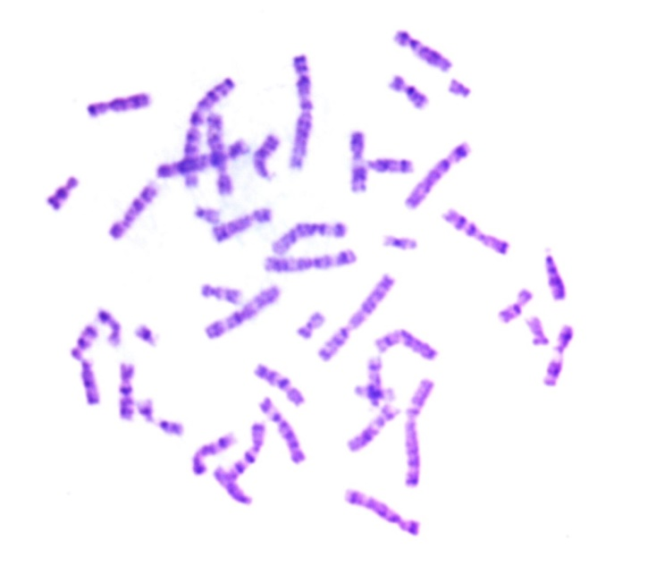
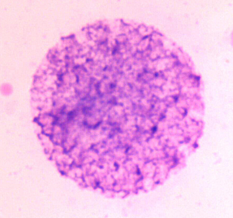
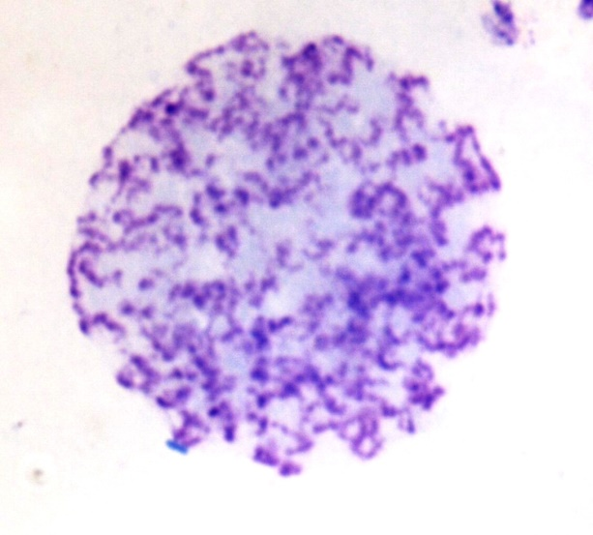
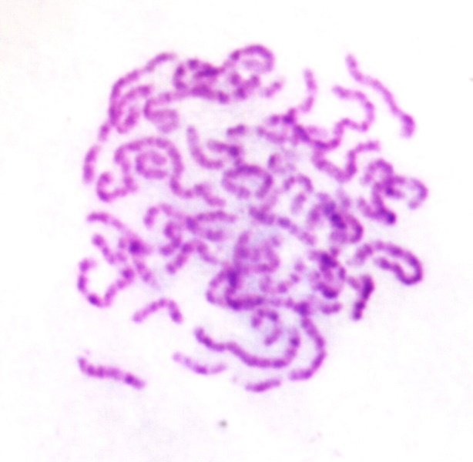
Nucleus
Interphase to Metaphase

Slide 16
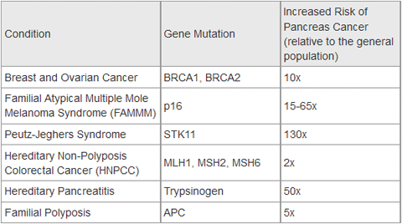
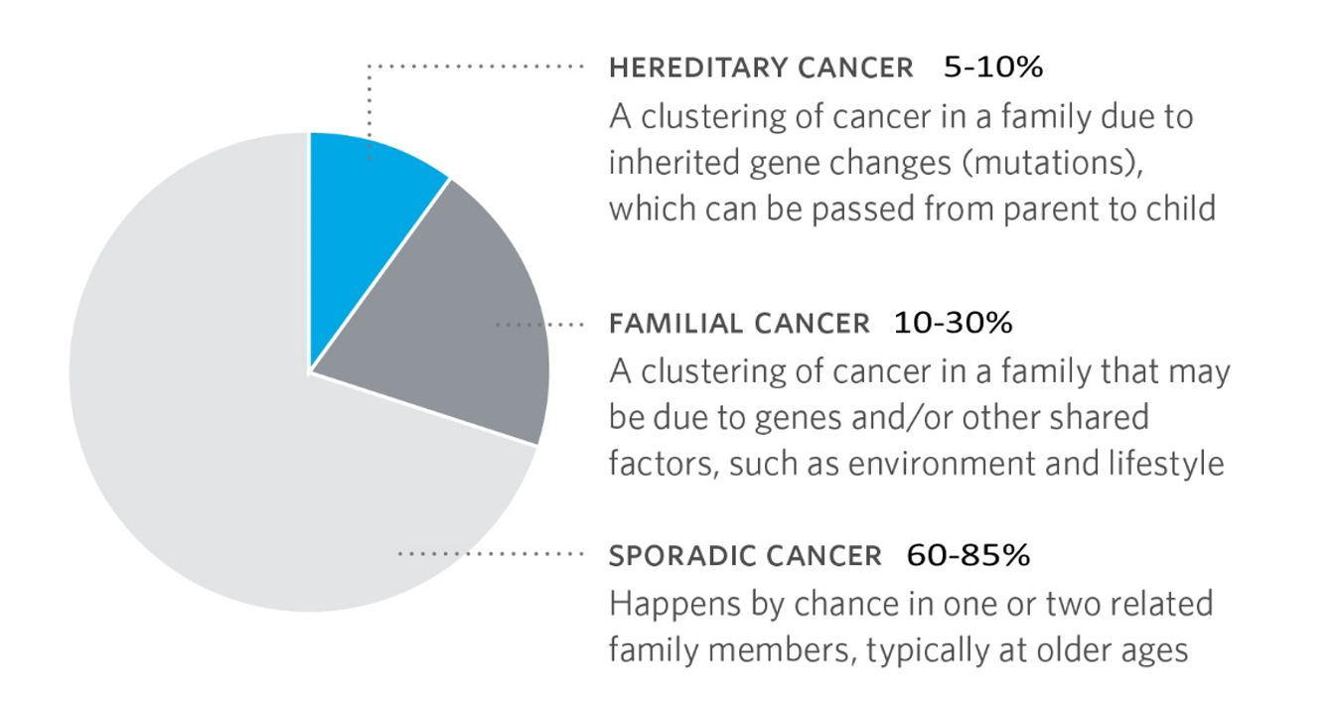
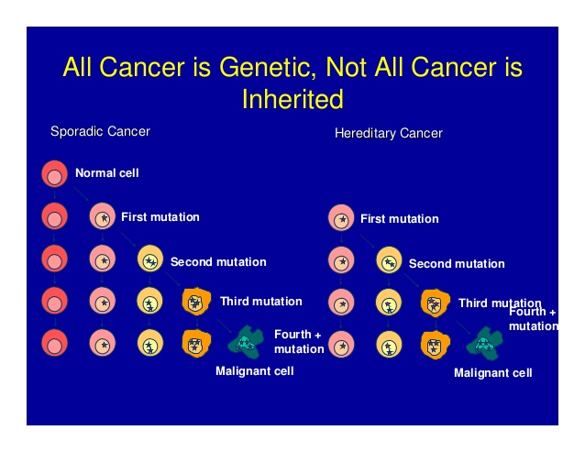
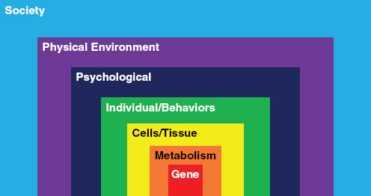
Inherited Cancer

Slide 17
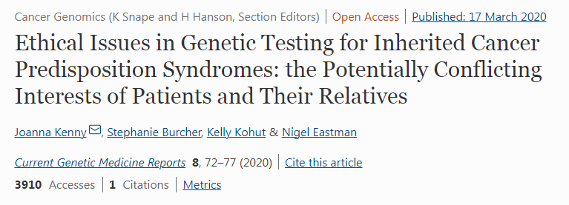

Inherited Cancer genes testing dilemma

Slide 18
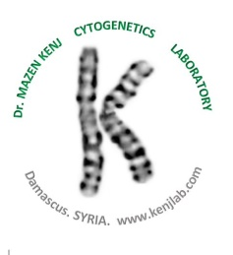
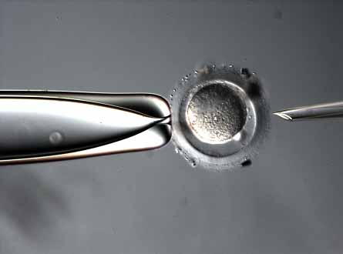
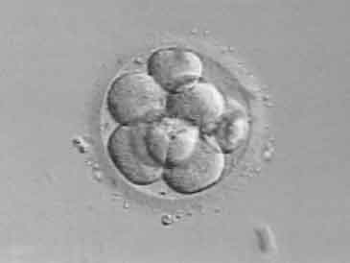
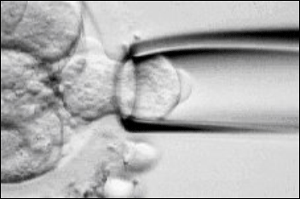
Preimplantation Genetic Diagnosis by IVF
Exclude Embryos with undesirable inherited mutations.

Slide 19
Genetic testing in Cancer
Diagnosis.
Classification and Subtyping.
Treatment selection. (Pharmacogenetics, Targeted Therapy...).
Response prediction.
Response monitoring.
Prognosis.
Risk assessment (in Hereditary and Familial Cancer ).
Research.

Slide 20
Genetic Material
Microscopic level (light & electron) | Molecular level
Nucleus. | DNA
 | RNA
Chromatin | Gene
 | Genome
Chromosomes | Exome
 | Transcriptome

Slide 21
Cancer Genetic Methodology
Cytogenetics | Molecular Cytogenetics | Molecular Biology
Karyotyping | FISH | PCR
 |  | REAL TIME PCR
 |  | Digital PCR
 | CGH | Proteomics
 |  | DNA \ RNA Sequencing
 | Array CGH | NGS

Slide 22
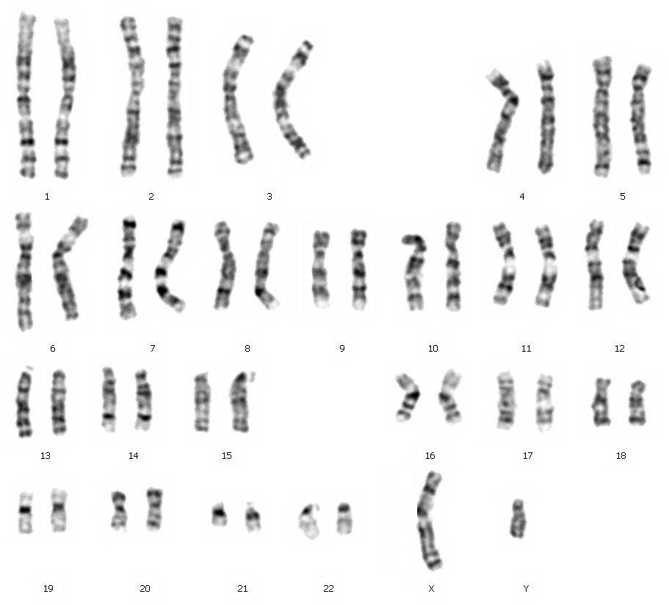
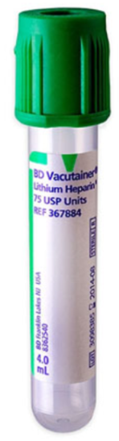
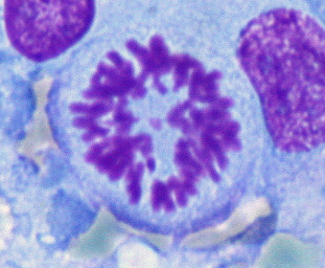
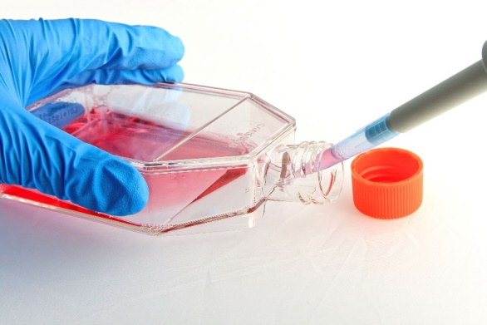
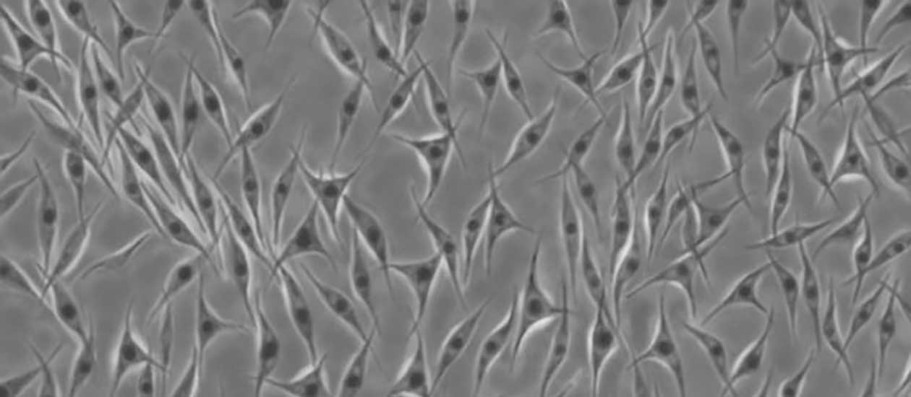

Slide 23
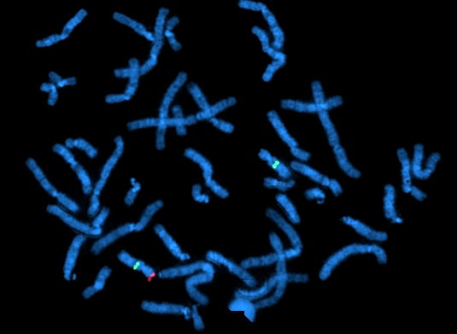



Slide 24
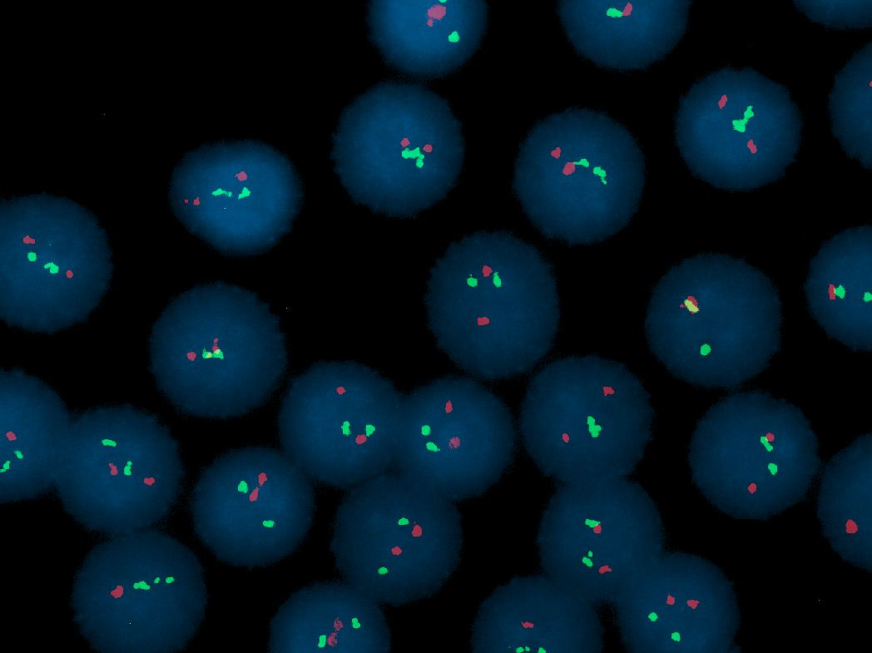


Slide 25
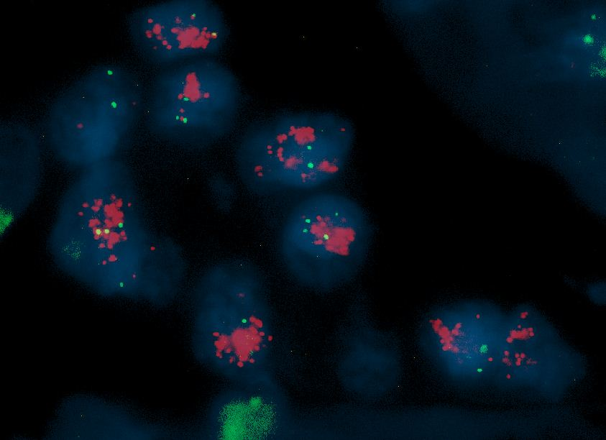


Slide 26

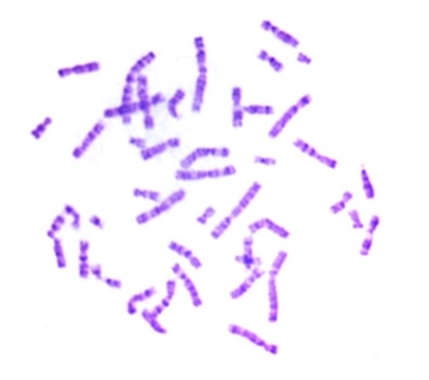
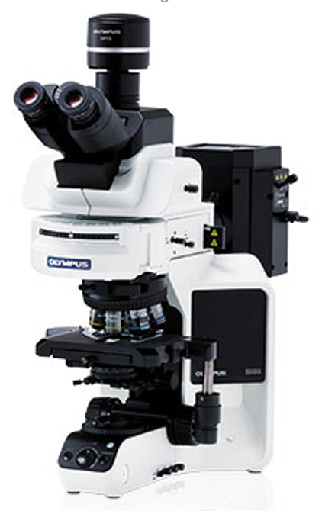
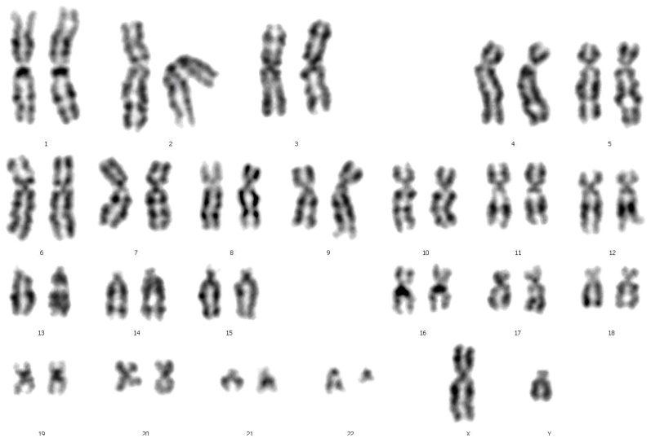
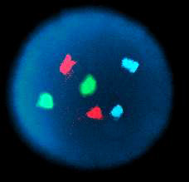
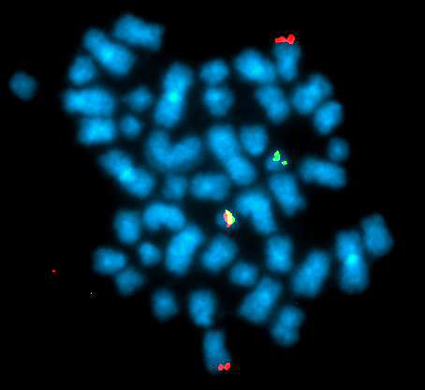

Slide 27
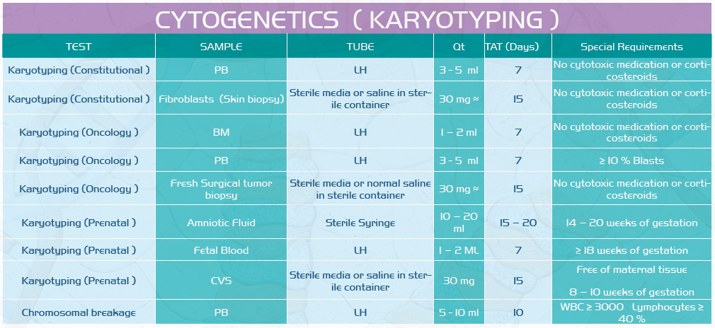

Slide 28
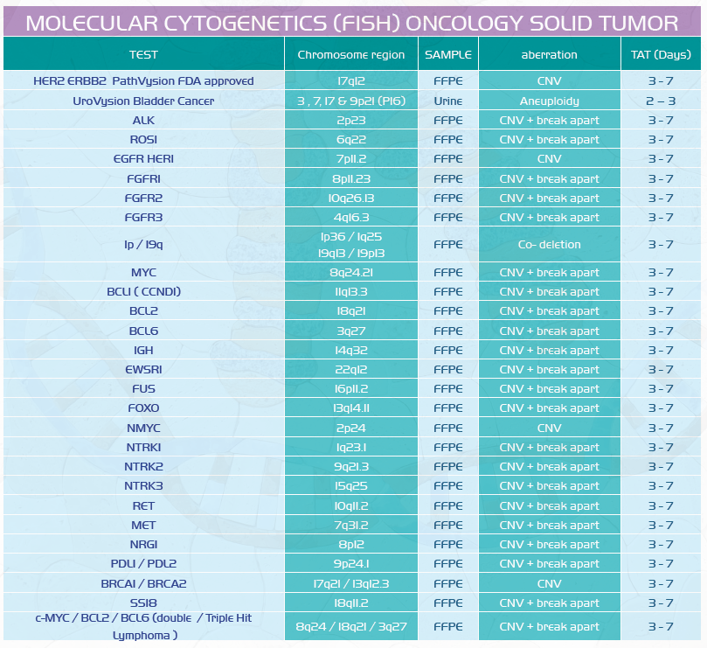

Slide 29
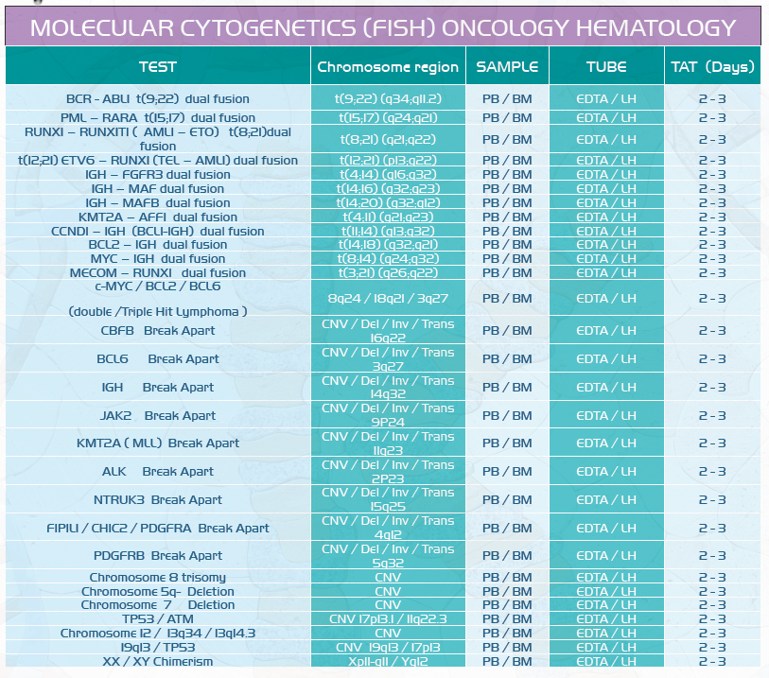

Slide 30

Molecular Genetics
DNA , RNA Level.

Slide 31
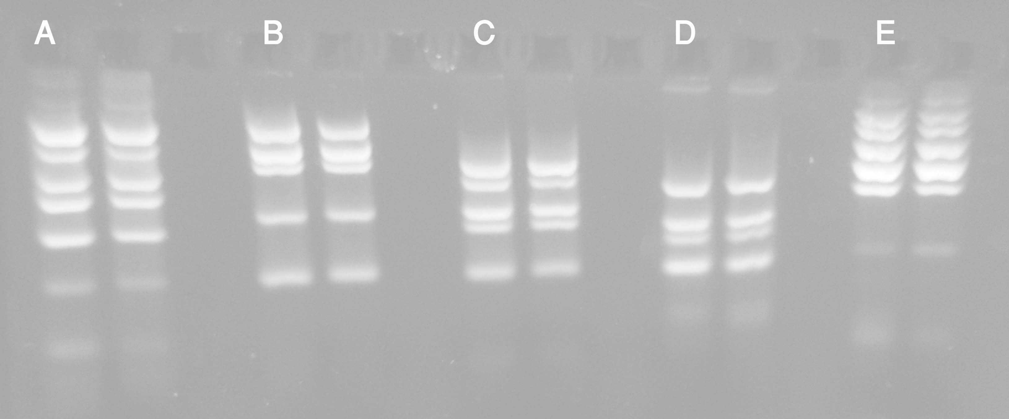
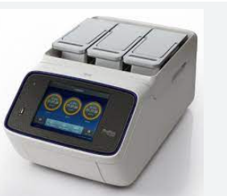
Polymerase Chain Reaction PCR

Slide 32
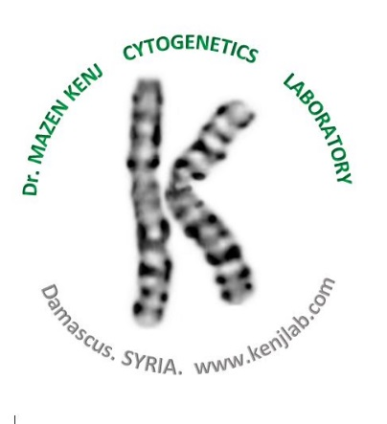

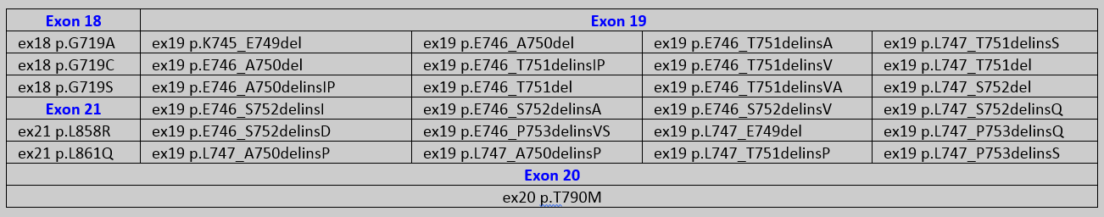
EGFR 30 Mutations

Slide 33
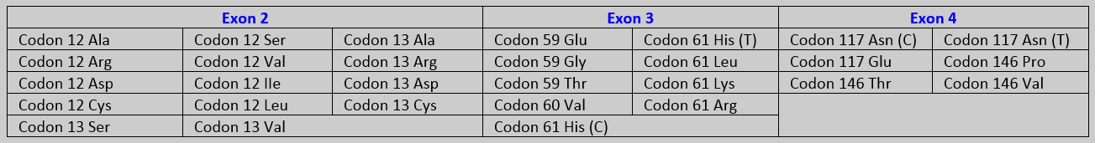
KRAS 29 Mutations

Slide 34
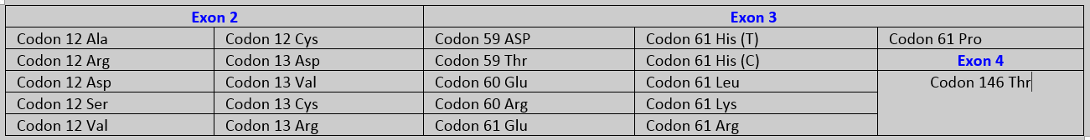
NRAS 22 Mutations

Slide 35
BRAF 9 Mutations

Slide 36
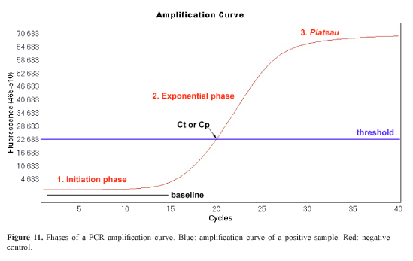
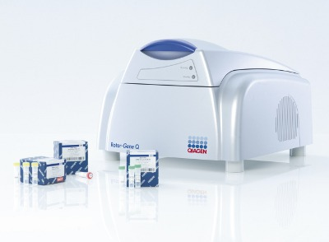
Real Time PCR
Detection and Quantification simultaneously.

Slide 37

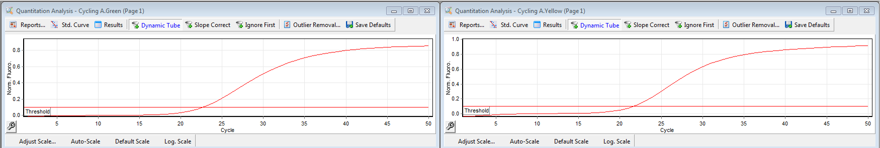
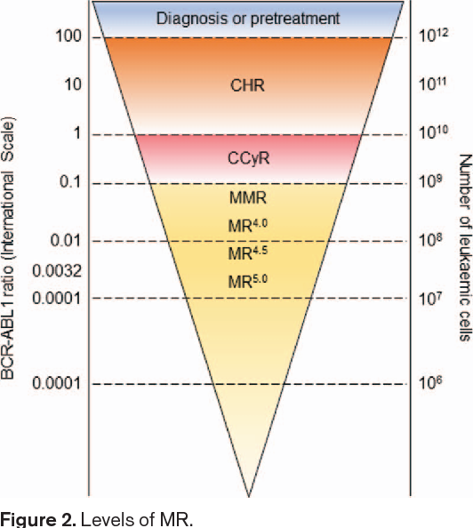
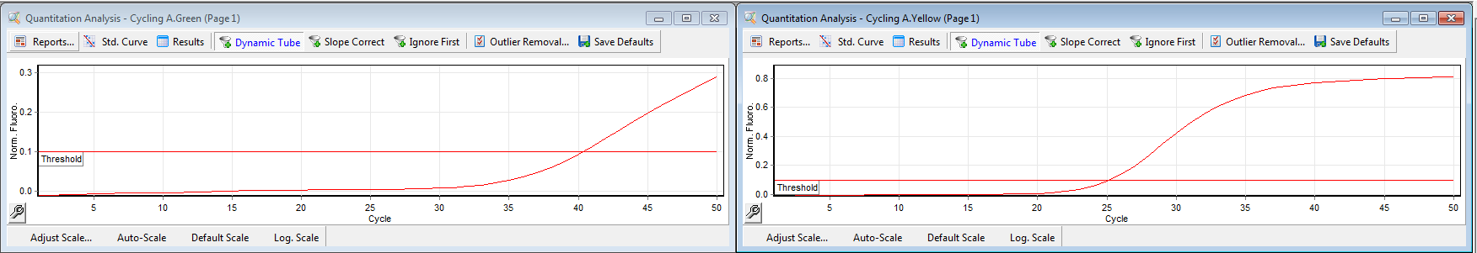
BCR – ABL / ABL Relative Quantification (MRD)

Slide 38
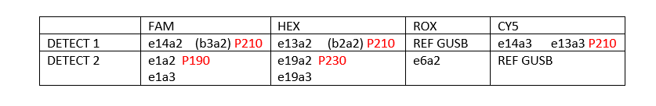
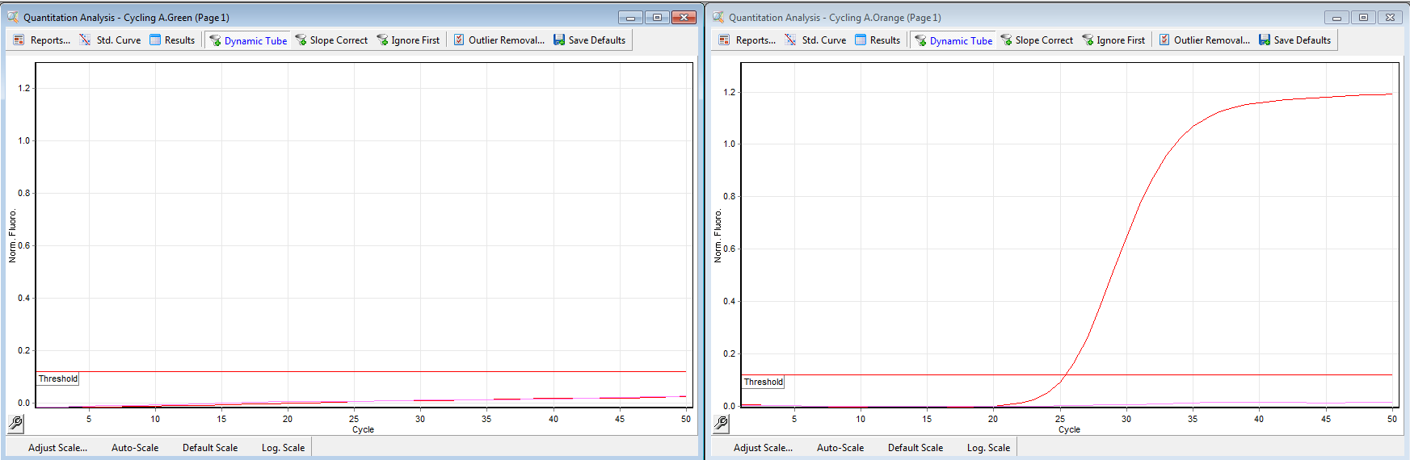
BCR – ABL Fusion Genotyping

Slide 39
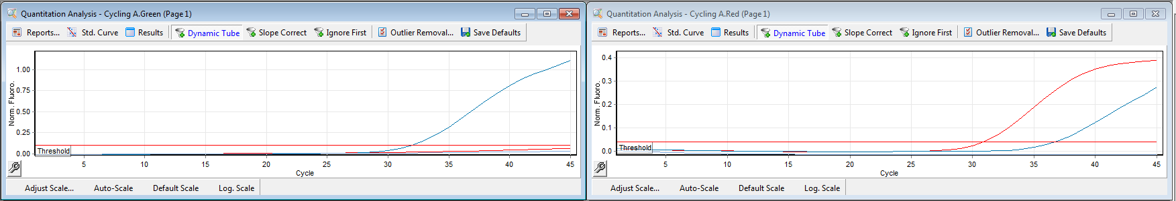
EGFR KRAS NRAS BRAF Mutation Detection (Liquid Biopsy)

Slide 40


MET Exon 14 skipping Mutations (3% NSCLC)
(Adeno + Squamous) FFPE

Slide 41




Slide 42
EGFR Status in Kenj Genetic Labs - Syria
(NSCLC)
June. 2011 – Jan. 2020
June. 2011 - Aug 2022
993 patients.
186 EGFR positive 18.7 %.
53.5 % females (EGFR +).
66 % Non smokers.
1404 patients.
251 EGFR positive 17.87 %.
55 % females (EGFR +).
64 % Non smokers.

Slide 43
EGFR Status in Kenj Genetic Labs – Syria
(NSCLC)
EXON 19 : 58%. Exon 19 p. E746-A750 del c.2235-2249 del 34.4%
EXON 21 : 22.5%.
EXON 18 : 13.7%.
EXON 20 : 5.3%.

Slide 44

KRAS Status in Kenj Genetic Labs - Syria
(CRCs)
Dec. 2010 – Aug 2022
1275 patients.
571 KRAS positive 44.78 %.
52.1 % Males.
EXON2 92.5 %
KRAS codon 12 Asp (KRAS c.35G>A (G12D)) 37.3 %. (16.7 % of patients)
KRAS codon 12 CYS (KRAS c.34G>T (G12C)). 7.5%. (3.3 % of patients)

Slide 45


Slide 46


The Cancer Genome Atlas (TCGA), a landmark cancer genomics program, molecularly characterized over 20,000 primary cancer and matched normal samples spanning 33 cancer types. This joint effort between NCI and the National Human Genome Research Institute began in 2006, bringing together researchers from diverse disciplines and multiple institutions.
The Cancer Genome Atlas
TCGA

Slide 47


Slide 48


NGS Oncomine ™ Comprehensive Assay v3 for Solid Tumors
DNA DNA DNA RNA

Slide 49

TML (TMB)
Tumor Mutation Load (Tumor Mutation Burden)

Slide 50
TML (TMB)
Tumor Mutation Load (Tumor Mutation Burden)
the number of somatic mutations in cancer cells that occur per Megabase of genetic regions of interest.
Cancers with a TMB ≥10 mut/Mb may be more likely to respond to immune checkpoint inhibitors that help activate the immune system to better recognize cancer cells. ( PD1, PD-L1, CTLA4 & LAG-3 Inhibitors ).

Slide 51


NGS Oncomine ™ Precision Assay
Liquid Biopsy for Solid Tumors
cfDNA cfDNA cfRNA cfRNA

Slide 52


Slide 53



Case 3 : 47;XX PML –RARA Neg
NGS : IDH2+ NPM1+

Slide 54
NGS main applications
WGS : WHOLE GENOME SEQUENCING.
WES : WHOLE EXOME SEQUENCING.
TRANSCRIPTOME.
MICROBIUM studies.
HLA TYPING.
NGS PANELS.
Single gene deep sequencing.

Slide 55


NGS Micro organisms typing and variants monitoring

Slide 56


SARS-coV-2 Genotyping in SYRIA
6 Oct 2022

Slide 57


SARS-coV-2 Genotyping in SYRIA
6 Oct 2022

Slide 58

SARS-coV-2 Genotyping in SYRIA
4 random samples Omicron BA.5.2

Slide 59


Slide 60


Slide 61


Slide 62


Slide 63


Slide 64



Slide 65





Slide 66


Slide 67


Slide 68
Case study of nmCRPC
Dr Z Marawi
Head of Urogynecology department

Slide 69
FDA Approvals of Next-Generation Antiandrogens for Nonmetastatic Castration-Resistant Prostate Cancer (CRPC)
Agent | Approval date | Pivotal study
Darolutamide | July 30, 2019 | ARAMIS
Enzalutamide | July 12, 2018 | PROSPER
Apalutamide | February 14, 2018 | SPARTAN
https://www.fda.gov/drugs/resources-information-approved-drugs/

Slide 70

Apalutamide Treatment and Metastasis-free Survival in Prostate Cancer
N Engl J Med 2018; 378:1408-1418

Slide 71
Apalutamide Treatment and Metastasis-free Survival in Prostate Cancer
N Engl J Med 2018; 378:1408-1418

Slide 72

Case Presentation
70 Years Old Male with 2 years history of high-risk prostate cancer s/p.
Radiation therapy on continued ADT with Zoladex monthly.
His testosterone level less than 10. He has no symptoms but steady rise in PSA from 0.4 on 11/2020 to 8 on 6/2021.
His basic imaging and cbc, chemistry are unrevealing.
N Engl J Med 2018; 378:1408-1418

Slide 73
Case Presentation
What would be your recommendation?
N Engl J Med 2018; 378:1408-1418

Slide 74
Case Presentation
What would be your recommendation?
  Bicalutamide
  Flutamide
  Appalutamide
  Docetaxol
  Sipuleucel-T
N Engl J Med 2018; 378:1408-1418

Slide 75
Case Presentation
What would be your recommendation?
  Bicalutamide
  Flutamide
  Appalutamide
  Docetaxol
  Sipuleucel-T
N Engl J Med 2018; 378:1408-1418

Slide 76

Case Presentation

Slide 77


Slide 78



Primary Endpoint: Metastasis-Free Survival (MFS) in Nonmetastatic CRPC
SPARTAN¹
apalutamide
(APA)
72% reduction in distant progression or death
Median MFS: APA 40.5 vs placebo (PBO) 16.2 months
24-month MFS benefit
PROSPER²
enzalutamide
(ENZA)
71% reduction in distant progression or death
Median MFS: ENZA 36.6 vs PBO 14.7 months
22-month MFS benefit
ARAMIS³
darolutamide
(DARO)
59% reduction in distant progression or death
Median MFS: DARO 40.4 vs PBO 18.4 months
22-month MFS benefit
1. Smith MR et al. NEJM 2018;378(15):1408-18. 2. Hussain M et al. NEJM 2018;378(26):2465-74. 3. Fizazi K et al. NEJM 2019;380(13):1235-46.

Slide 79



Secondary Endpoint: Overall Survival (OS) in Nonmetastatic CRPC
SPARTAN1¹
apalutamide
22% reduction in risk of death
Median follow-up of 52.0 months
Median OS was significantly longer for apalutamide
vs placebo
  73.9 months vs 59.9 months
  HR = 0.78 (95% CI 0.64-0.96); p = 0.016
PROSPER²
enzalutamide
27% reduction in risk of death
Median follow-up of 48 months
Median OS was significantly longer for enzalutamide
vs placebo
  67.0 months vs 56.3 months
  HR = 0.73 (95% CI 0.61-0.89); p = 0.001
ARAMIS³
darolutamide
31% reduction in risk of death
Median follow-up of 29.0 months
Median OS was significantly longer for darolutamide
vs placebo
  HR = 0.69 (95% CI, 0.53-0.88); p = 0.003
1. Smith MR et al. Eur Urol 2020;79(1):150-8. 2. Sternberg CN et al. NEJM 2020;382(23):2197-206. 3. Fizazi K et al. NEJM 2020;383(11):1040-9.

Slide 80
Comparison of Toxicities: Darolutamide, Enzalutamide,
Apalutamide for Nonmetastatic CRPC
Toxicity | ARAMIS |  | PROSPER |  | SPARTAN
 | Darolutamide | Placebo | Enzalutamide | Placebo | Apalutamide | Placebo
Fatigue/asthenia | 16% | 11% | 33% | 14% | 30% | 21%
Falling | 4% | 5% | 11% | 4% | 16% | 9%
Dizziness | 5% | 4% | 10% | 4% | 9% | 6%
Mental impairment | 1% | 2% | 5% | 2% | 5% | 3%
Sternberg CN et al; PROSPER Investigators. N Engl J Med 2020;382(23):2197-206.
Fizazi K et al; ARAMIS Investigators. N Engl J Med 2020;383(11):1040-9.
Small EJ et al; SPARTAN Investigators. ASCO 2020;Abstract 5516.

Slide 81
Thank you

Slide 82
Relapsed Breast Cancer
Case Study
Dr Qossay ALHUSSEIN
Faculty of Medicine
Department of Hematology
ALMOUSSAT HOSPITAL

Slide 83

Female
Age : 57 years.
Post-menopause.
L breast Lumpectomy with AXLND
Stage : T3/N2
ER 80%/PR30%/HER –ve
AC x4/Taxol x 12 w
RT
Tamoxifen x 2 years
Anastrozol

Slide 84
2019
Cough, Dyspnea
CT pulmonary mets
PET CT confirmed mets (pulmonary,mediastinal)
Relapse while on Anstrazole

Slide 85
What are the treatment options?

Slide 86

Fulvestrant?
Everolimus + exemestane?
Chemotherapy?
CDK4/6 inhibitor + AI?
CDK4/6 inhibitor + Fluvestrant ?

Slide 87
Guideline Recommendations for ER-Positive/HER2-Negative MBC
In patient with visceral crisis and clear arguments for primary endocrine resistance, endocrine treatment is the preferred option(a-c)
Several options are possible in first-line MBC according to previous treatment exposure and "estimation" of endocrine sensitivity and patient parameters (a-c)
Among these options are CDK4/6 inhibitors which are showing promise and are continuing to become clinically useful in everyday practice.
a. Rugo H, et al. J Clin Oncal, 2016034:3069-3103.
b. NCCN Clinical Practice Guidelines in Oncology (NCCN Guidelines). Breast Cancer. V2.2017
c. cardosoF, et al.Annals of Oncology. 2017;28:16-33.

Slide 88
The Choice to Use ET Monotherapy or ET in Combination With Another Agent
• Fulvestrant 500 mg?
There is limited data on treatment for patients with de novo MBC.
FALCON study demonstrated PFS benefit with fulvestrant alone: median PFS was 16.6 months (95% CI 13.83, 20.99) in the fulvestrant group vs 13.8 months (11.99, 16.59) in the anastrozole group(a)
• The best possible treatment available should be offered to the patient
• For this patient, the preferred choice is the approved combination, Palbociclib plus letrozole.
Robertson JFR, et al. The Lancet. 2016:388:2997-3005

Slide 89
Patient Considerations
Clinicians must have good knowledge of patient and their fears of experiencing side effects
It is important to treat patients in a palliative setting
Facing recurrence is difficult for patients
Therefore, choosing a treatment which has shown a significant PFS is important to their quality of life to avoid recurrence.

Slide 90
Treatment protocol:
Palbociclib + Fluvestrunt.
Mild neutropenia
CT 6 months later : complete resolution of pulmonary mets
Stop or continue ?

Slide 91
Treatment protocol:
Stop or continue ?

Slide 92
Other Considerations With CDK4/6 Inhibitors
Co-medications
QT prolongation
Age: even if patient has good health status, must monitor patient closely after treatment initiation.

Slide 93
Managing Neutropenia Associated WithCDK4/6 Inhibitors
Grade* | Palbociclib Dose Adjustment
Grade 1 or 2 | No dose adjustment
Grade 3 uncomplicated neutropenia | Day 1 of cycle: withhold Palbociclib, repeat CBC monitoring within 1 week; when recovered to grade ≤ 2, start the next cycle at same dose. Day 14 of first 2 cycles: continue Palbociclib at current dose to complete cycle; repeat C8C on day21; consider dose reduction in cases of prolonged (>1 week) recovery from grade 3 or recurrent grade3 neutropenia in subsequent cycles
Grade 3 neutropenia with documented infection or fever < 38.5C | Withhold Palbociclib until recovery to grade ≤ 2: resume at next lower dose
Grade 4 neutropenia | Withhold Palbociclib until recovery to grade ≤ 2; resume at next lower dose

Slide 94
QT Monitoring and CDK4/6 Inhibitors
The ULN for a cardiac frequency of 60 beats/min is theoretically
  450 msec in men; "borderline if 430 to 450 msec”
  470 msec in women; "borderline if 450 to 470 msec”
Monitoring QT interval is required for ribociclib but not Palbociclib^{{a-b}}
Robertson JFR, et al. The Lancet. 2016:388:2997-3005

Slide 95
QT Monitoring and CDK4/6 Inhibitors
The effect of palbociclib on the QT interval corrected for heart rate (QTc) interval was evaluated using time matched ECG change from baseline and PK data ^{{a}}
  The upper bound of the one-sided 95% Ci for the increase from baseline in QTc at all time points at steady state concentrations at the recommended dose of 125 mg was less than 8 msec;
  Therefore, at the recommended dose, no palbociclib relevant effects on QT have been observed
Robertson JFR, et al. The Lancet. 2016:388:2997-3005

Slide 96
QT Monitoring and CDK4/6 Inhibitors
Ribociclib has been shown to prolong the QT interval in a concentration-dependent manner, with estimated mean increase in QT interval exceeding 20 ms (22.9 ms (90% CI: 21.6, 24.1)) at the mean steady-state Cmax following administration at 600 mg once daily dose ^{{b }}
Dose modification and management for QT prolongation when using ribociclib can be found in the PI
Robertson JFR, et al. The Lancet. 2016:388:2997-3005

Slide 97

Patient’s updates
Continue Palbociclib 16 months
All CT was normal
Continued Fluvestrant
Still on Fluvestrant 2 years later she is doing well
Robertson JFR, et al. The Lancet. 2016:388:2997-3005

Slide 98
Concluding Remarks (cont)
The choice of which CDK4/6 inhibitor to use and which ET to combine it with depends on the clinical and biological parameters of the patient
Safety profiles always need to be considered
  Neutropenia
  QT prolongation
Robertson JFR, et al. The Lancet. 2016:388:2997-3005

Slide 99
Thank you

